Slide 1
HNDIT1101: Personal Computer Applications
Week 06

Slide 2
Introducing Functions
Functions are predefined formulas that perform calculations by using specific values, called arguments, in a particular order, or structure
=sum(A8,B4:B8,50,70)
Function name
A comma separates each argument

Slide 3
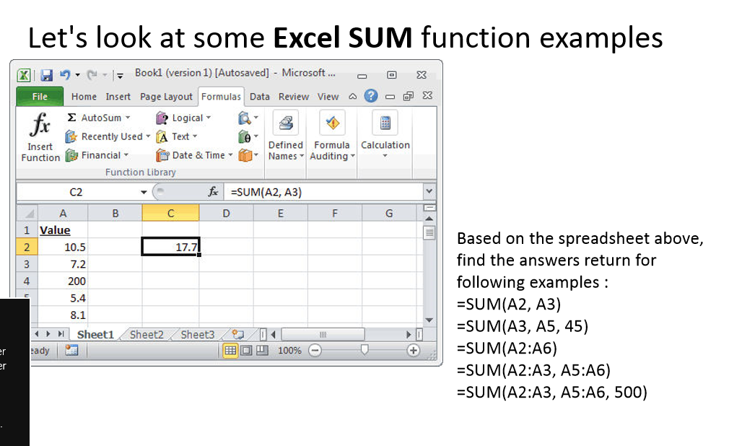
Functions
SUM: Adds a range of cells together
  Syntax
  =SUM(number1,number2, ...)
  Number1, number2, ... are 1 to 30 arguments for which you want the total value or sum.

Slide 4
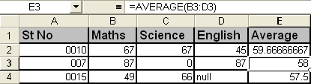
=Average(number1,number2,….)
Returns the average (arithmetic mean) of the arguments.
Syntax
AVERAGE(number1,number2, ...)
Number1, number2, ... are 1 to 30 numeric arguments for which you want the average.
E.g
=Average(B4:D4)
=(49+66)/2
=57.5
Average(B2:D2)
=(67+67+45)/3
=59.66
Note: If an array or reference argument contains text, logical
values, or empty cells, those values are ignored; however,
cells with the value zero are included.

Slide 5

Averagea(value1,value2,…)
Calculates the average (arithmetic mean) of the values in the list of arguments. In addition to numbers, text and logical values such as TRUE and FALSE are included in the calculation.
Syntax
AVERAGEA(value1,value2,...)
Average(B4:D4)
=(49+66)/3
=38.333
Average(B2:D2)
=(67+67+45)/3
=59.66

Slide 6
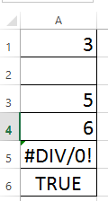
Count Function
Counts the number of chosen data in a range of cells
Syntax:
= COUNT(data range)
COUNT Function Rules:
  It only counts cells containing numbers
  It ignores blank cells
  It ignores cells containing anything but a number
Syntax:
=COUNTA(data range)
COUNTA function counts cells that are not empty.
That means it includes error values, like #VALUE!, numbers
, logical values or text.
=COUNTA(A1:A6)=5
=COUNT(A1:A6)=3

Slide 7
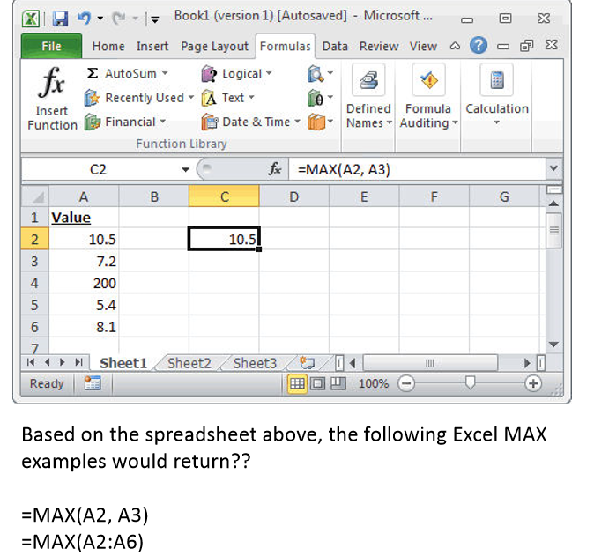
MAX(range)
Maximum value in data range

Slide 8
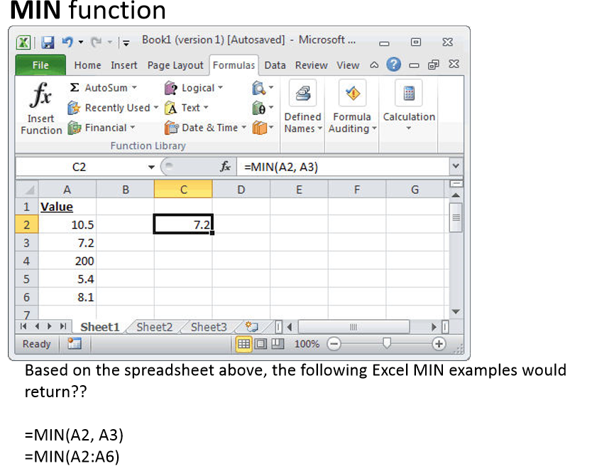
=Min(range)
Minimum value in data range

Slide 9
If function
The if function is used to evaluate a condition and to perform one of two operations depend on whether the condition evaluates to TRUE or FALSE.
Syntax:
  =IF(logical_test, value_if_true, value_if_false)

Slide 10
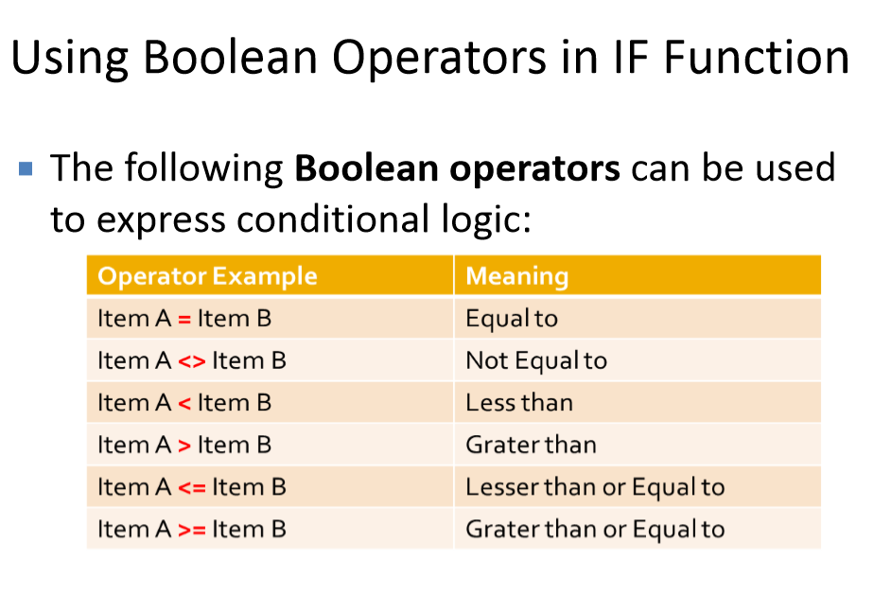

Slide 11
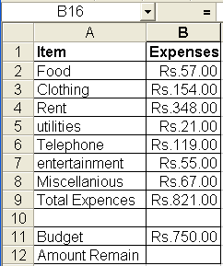
Example
If total expense are grated than the amount budget, you may want to display a warning. If not you would display the amount of money left in the budget.
Write the correct formula to express the given conditions.
Notes:
=IF(B9>B11,"over budget",B11-B9)

Slide 12
Nested if
Up to seven IF functions can be nested as value_if_true and value_if_false arguments to construct more elaborate tests.
Two If syntax
= IF (Cond 1, IF(Cond 2, X2, Y2)Y1)
Three If syntax
=IF(Cond1, IF(Cond2,IF(Cond3,X3,Y3),Y2),Y1)
Notes:
It allows you to evaluate one range of cells and based upon the contents of that range, total a different range of cells.
Last argument is optional.

Slide 13
Example
Dehiwala Zoo gives a number of different discounts based on the age of the visitors. Senior Citizens(over 65 years) pay only Rs.25.00 per tickets. Children from 15th to 5 years old are Rs.15.00 and children under 5 are free. All others are charged Rs. 50.00.

Slide 14
Using compound conditions in IF functions
Conditional logic can be compounded by including the and or or functions within the logical text argument of an if function.
The syntax of compound and function as follows (if all arguments are true)
= IF (AND(cond 1, cond 2,cond 3,----)X,Y)
The syntax of compound or function as follows (only one argument need to be true)
=IF (OR(cond 1, cond 2, cond 3,-----) X,Y)

Slide 15
AND function
AND function
Returns TRUE if all its arguments evaluate to TRUE; returns FALSE if one or more arguments evaluate to FALSE.
Syntax
=AND(logical1, [logical2], ...)

Slide 16
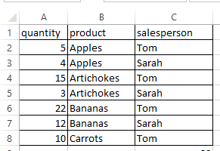
01 Example
Find the products, product is sold by Tom AND quantity grater than 5.

Slide 17
02 Example
Find the products, product is sold by Sarah AND quantity less than 10.

Slide 18
OR function
Returns TRUE if any argument is TRUE; returns FALSE if all arguments are FALSE.
Syntax
=OR(logical1, [logical2], ...)

Slide 19
01 Example
Find the products, product is sold by Tom OR quantity grater than 5.
Find the products, product is sold by Sarah OR quantity less than 10.

Slide 20
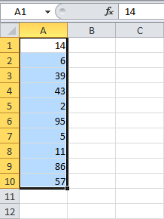
Conditional formatting
Conditional formatting in Excel enables you to highlight cells with a certain color, depending on the cell's value.
Highlight Cells Rules
To highlight cells that are greater than a value, execute the following steps.
1. Select the range A1:A10.

Slide 21
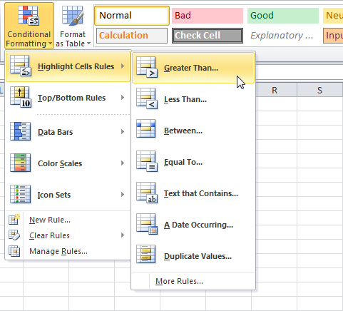
2. On the Home tab, click Conditional Formatting, Highlight Cells Rules, Greater Than...

Slide 22
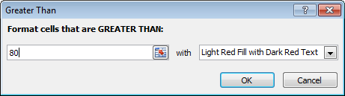
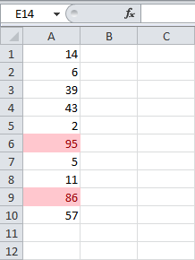
Enter the value 80 and select a formatting style.
Click OK.
Result. Excel highlights the cells that are greater than 80.

Slide 23
The sumif function
Using this function you can sum all the entries in one column or row that match the given criteria that depend on another column or row.
Syntax:
=sumif( criteria range, criteria, sum range)

Slide 24
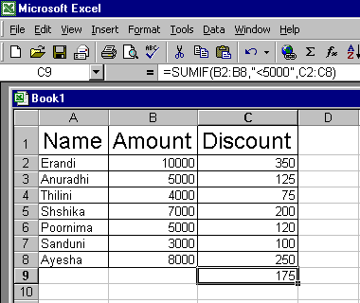
Select sum of discount where amount less than 5000
Example:

Slide 25
=sumifs()
The SUMIFS function, one of the math functions, adds all of its arguments that meet multiple criteria
Syntax:
=SUMIFS(sum_range, criteria_range1, criteria1, [criteria_range2, criteria2], ...)

Slide 26
Example:
Find the sum of discount which amount is grater than 5000 and name is Anuradi.

Slide 27
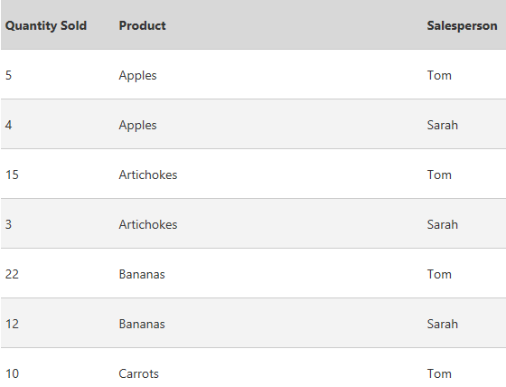
Find the number of products that begin with letter A and product sold by Tom.

Slide 28
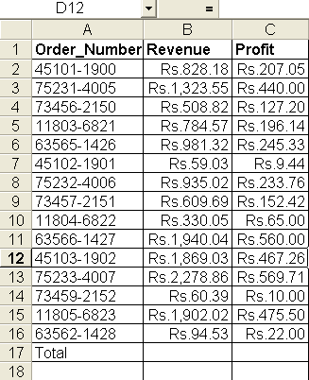
Example
Evaluate the profits to determine what percentage of their profits come from small orders those with a revenue less that Rs 100.00 and what percentage come from large orders.

Slide 29
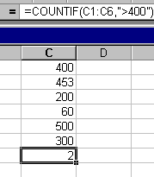
Count if
=Countif (range,criteria)
Count the number of cells within a range the meet the given criteria.
Example:
Count the number of cells that
cell value is grater than 400

Slide 30
=countifs()
Show All
Hide All
)
Applies criteria to cells across multiple ranges and counts the number of times all criteria are met.
Syntax
=COUNTIFS(criteria_range1, criteria1, [criteria_range2, criteria2]…

Slide 31
Eg:
Count the number of cells that quantity is grater than 10 and Sales person is Tom
=countifs(A2:A8;”>10”,C2:C8,”Tom”)

Slide 32
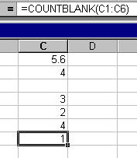
Countblank(rage)
Count the number of empty cell.
Example
  Find the number of empty cells.

Slide 33
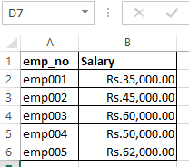
Averageif()
Returns the average (arithmetic mean) of all the cells in a range that meet a given criteria.
Syntax
=AVERAGEIF(range, criteria, [average_range])
Example:
Find the average salary of employees who’s
salary is grater than 50,000.
=AVERAGEIF(B2:B6,">50000",B2:B6)

Slide 34
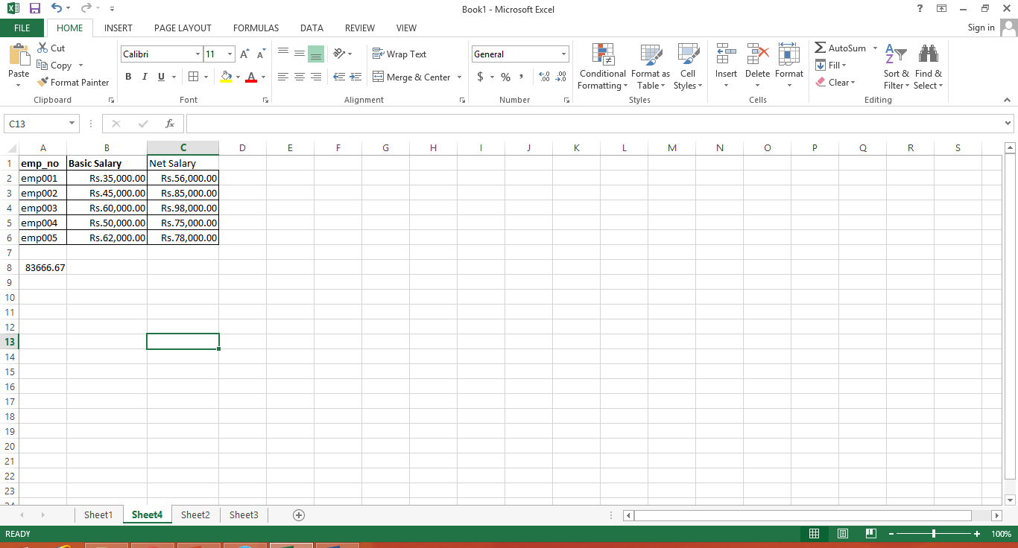
=Averageifs()
Returns the average (arithmetic mean) of all cells that meet multiple criteria.
Syntax
=AVERAGEIFS(average_range, criteria_range1, criteria1, [criteria_range2, criteria2,………………..)
Example:
  Calculate the average net salary of employee who earn more than 50 000 basic salary and more than 60000 net salary.
=AVERAGEIFS(C2:C6,B2:B6,">45000",C2:C6,">60000")

Slide 35
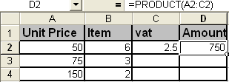
PRODUCT(number1,number2, ...)
Syntax
=PRODUCT(number1,number2, ...)
The PRODUCT function multiplies all the numbers given as arguments and returns the product.
Number1, number2, ... are 1 to 30 numbers that you want to multiply.

Slide 36
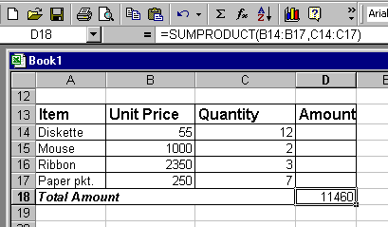
=Sumproduct(array 1,array,....)
Multiplies corresponding components in the given arrays, and returns the sum of those products.
  Array1, array2, array3, ... are 2 to 30 arrays whose components you want to multiply and then add.
  The array arguments must have the same dimensions. If they do not, SUMPRODUCT returns the #VALUE! error value.

Slide 37
END

